Slide 1
What is left to do in MDA Class
3 December: Homework report deadline
10 December: List of Exam Paper questions
6, 13 December lectures on
clustering similarity data
consensus clustering
20 December Lecture: Revision and Question Answering
24 December in-Class Exam Paper (After-Exam Meeting 28 December)

Slide 2
Week 8. Correlation rules
CONTENTS
Popular correlation structures.
Bayes approach to prediction and Naïve Bayes classifier.
Assigning articles to categories: Naïve Bayes algorithm.
Bag-of-words text model.
Decision tree and splitting criteria.
Metrics of accuracy.

Slide 3
Week 8. I: Correlation structures, 1
Typically, to analyze relations between different aspects, all the features are divided in two parts:
input features X (one aspect) and
target features U (another aspect).
Then a rule F is sought to establish a relation between the input and target features, most usefully like U=F(X). This would allow for predicting U from X.

Slide 4
Week 8. I: Correlation structures, 2
Rule U=F(X) can be used for prediction of U from X. Because of its practical importance, the problem has received huge attention by researchers.
Several interesting forms of rules have been explored. Among them:

Slide 5
Week 8. I: Correlation structures, 3
Among popular types of rule U=F(X):
Linear Regression
Econometric structural model
Hidden Markov chain
Bayes network
Neural network
Decision tree

Slide 6
Linear regression u = f(x₁, x₂,… x_{p}), 1
u = w1*x₁+w2*x₂+…+wp*x_{p}+w0 ?
With w0, w1,…, wp unknown constants.
Take N×(p+1) matrix X=(x₁,x₂,…, x_{p}, x₀) with N×1 feature columns x₁,x₂,…, x_{p}, x₀, where all components of x₀ are 1 (unities).
Then the least squares problem is to find (p+1)-dimensional w=(w₁,w₂,…, w_{p}, w₀) so that

Slide 7
Linear regression u = f(x₁, x₂,… x_{p}), 2
u = w1*x₁+w2*x₂+…+wp*x_{p}+w0 ?
Take N×(p+1) matrix X=(x₁,x₂,…, x_{p}, x₀)
Find w=(w₁,w₂,…, w_{p}, w₀) so that N×1 vector û=Xw minimizes ǁu- ûǁ² over all possible w !

Slide 8
Linear regression u = f(x₁, x₂,… x_{p}), 3
u = w1*x₁+w2*x₂+…+wp*x_{p}+w0 ?
Take X=(x₁,x₂,…, x_{p}, x₀)
Find w to minimize ǁu- ûǁ² with û=Xw!
Solution: Orthogonal N×N projector
P_{X} = X(X^{T}X)⁻¹X^{T}
Makes that: û= P_{X} u= X(X^{T}X)⁻¹X^{T}u, so that
w= (X^{T}X)⁻¹X^{T}u

Slide 9
Linear regression u = f(x₁, x₂,… x_{p}), 4
u = w1*x₁+w2*x₂+…+wp*x_{p}+w0
Solution: Orthogonal N×N projector
P_{X} = X(X^{T}X)⁻¹X^{T}
Makes that: û= P_{X} u= X(X^{T}X)⁻¹X^{T}u, so that
w= (X^{T}X)⁻¹X^{T}u
This also can be applied to the problem of linear discrimination of two classes
at corresponding us

Slide 10
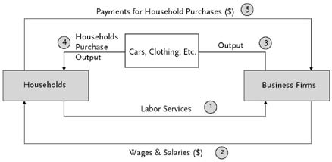
Week 8.: Rule U=F(X) (Ii)
Econometric structural model of dynamics: features relate according to a predefined structure; some of them are exogenous (external), some endogenous (internal). Issues: (a) unmeasurable variables, (b) instability of processes, (c) non-linear, largely unknown, relations.
The diagram is from http://www.econlib.org/library/Enc/ForecastingandEconometricModels.html#lfHendersonCEE2-062_figure_021

Slide 11
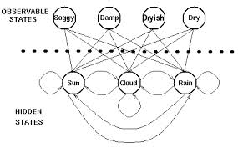
Week 8. I: Rule U=F(X) (iii)
(iii) Hidden Markov chain
Example: Using seaweed to predict the weather:
Using observable states to predict hidden states.
Hidden states form a simple
probabilistic process,
Markov chain, related to
observable states by a confusion
matrix. Issues: too complex
to fit, too simplistic to model
real world dynamics sometimes.
The diagram is from http://www.comp.leeds.ac.uk/roger/HiddenMarkovModels/html_dev/hidden_patterns/s2_pg1.html

Slide 12
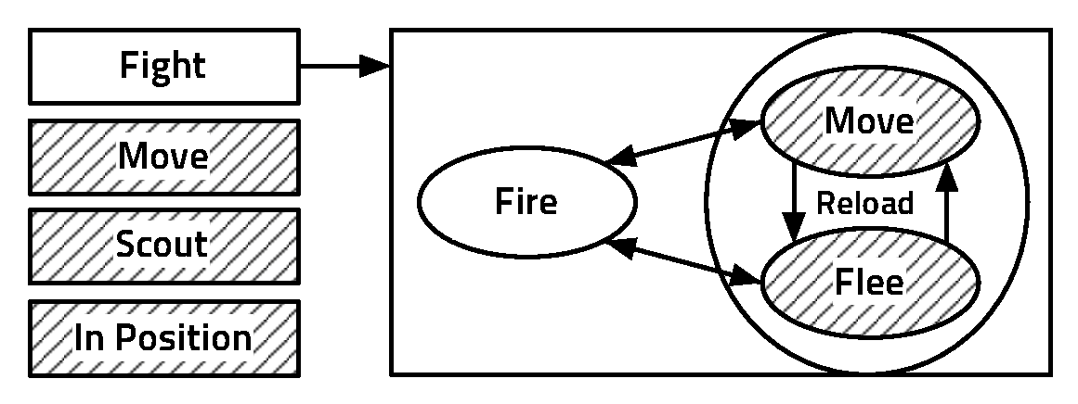
Week 8. I: Rule U=F(X) (iv)
(iv) Bayes network
See: http://emotion.inrialpes.fr/people/synnaeve/phdthesis/phdthesis.html#x1-610003.2.2
Example: network of variables describing a class of computer games, with a dependence graph imposed on them. The outcome probabilities depend on those of others according to the graph structure. Issue: finding a simple and adequate structure.

Slide 13
Week 8. I: Rule U=F(X) (v)
(v) Neural network (diagram is from Mirkin 2011)
Feed-forward Neural Network for relating Iris sepal measures (x₁, x₂) with Iris petal measures (u₁, u₂). One hidden layer. Issues: arbitrariness of the structure; lack of interpretation; inadequacy regarding real phenomena.
Yet the deep learning paradigm has revived the approach and now leads the way in Data Science

Slide 14
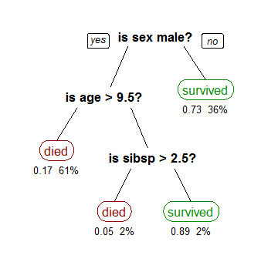
Week 8. I: Rule U=F(X) (vi)
(vi) Decision tree
From http://en.wikipedia.org/wiki/Decision_tree_learning
A tree showing survival of
passengers on the Titanic;
"sibsp" is the number of
spouses+siblings aboard.
The figures under
the leaves: the probability
of survival and the percen-
tage of observations.
Much interpretable, yet
may be unreliable at
weak correlation situations.

Slide 15
Week 8. I: Correlation structures, 4
I have presented six types of U=F(X) rules:
Linear regression
Econometric structural model
Hidden Markov chain
Bayes network
Neural network
Decision tree
Two subjects, (iv) and (vi), are touched in more detail in the remainder of this slide set.

Slide 16
Week 8. II: Naïve Bayes classifier, 1
This relates to rule (iv) Bayes network, in Bayes part rather than network part (“network” with no links).
T. Bayes’ (1702-1761) perspective at data analysis:
“There is a probabilistic distribution over
patterns. Observed entities change that from
a prior one to a posterior distribution.”

Slide 17
Week 8. II: Naïve Bayes classifier, 2
A database of 12×10 newspaper article-to-keyword items. Article labels: F for feminism, E for entertainment, and H for household. Problem: Classify the last item x, of an unknown category.
Article | Keyword
 | drink equal fuel play popular price relief talent tax woman
F1 F2 F3 F4 E1 E2 E3 E4 H1 H2 H3 H4 x | 1 2 0 1 2 0 0 0 0 2 0 0 0 1 0 1 0 2 0 2 0 2 0 0 0 0 0 1 0 2 2 1 0 0 0 2 0 2 0 1 2 0 1 2 2 0 0 1 0 0 0 1 0 3 2 1 2 0 0 0 1 0 2 0 1 1 0 3 1 1 0 1 0 1 1 0 1 1 0 0 0 0 2 0 1 2 0 0 2 0 1 0 2 2 0 2 2 0 0 0 0 0 1 1 2 1 1 0 2 0 0 0 1 0 0 2 2 0 2 0 1 1 2 1 1 0 0 1 0 0

Slide 18
Week 8. II: Naïve Bayes classifier, 3
A database of 12×10 newspaper article-to-keyword items. Article labels: F for feminism, E for entertainment, and H for household. Problem: Classify the last item x, of an unknown category.
Bayesian thinking:
Consider the prior situation according to the 12 item database: three classes, F,E, and H, probabilities of which are p(F)=1/3, p(E)=1/3, p(H)=1/3. Indeed of the 12 items, each class accounts for 4 of the, leading to 4/12 proportion.
Assume we can derive probabilities of x in each of the classes, p(x|F), p(x|E), p(x|F) from the database. Then the posterior probabilities of the classes will be proportional to the products (Bayes theorem):
P(F|x)=p(x|F)p(F), P(E|x)=p(x|E)p(E), P(H|x)=p(x|H)p(H).
Therefore, the Bayesian solution:
Assign x to category with maximum posterior probability.

Slide 19
Week 8. II: Naïve Bayes classifier, 4
A database of 12×10 newspaper article-to-keyword items. Article labels: F for feminism, E for entertainment, and H for household. Problem: Classify the last item x, of an unknown category.
Bayesian solution:
Assign x to category with maximum posterior probability, or that of maximum among
P(F,x)=p(x|F)p(F), P(E,x)=p(x|E)p(E), P(H,x)=p(x|H)p(H).
Caveat: How can we derive probabilities of x in each of the classes, p(x|F), p(x|E), p(x|H) from the database?

Slide 20
Week 8. II: Naïve Bayes classifier, 5
Caveat: How can we derive probabilities of x in each of the classes, p(x|F), p(x|E), p(x|H) from the database?
An universal advice: Be naïve!
The nature favors the naivete. Similar principles: Occam razor, Maximum parsimony, Minimum length, Maximum likelihood. Of course each of these is utterly wrong, yet usually conclusions derived from them are quite reasonable.

Slide 21
Week 8. II: Naïve Bayes classifier, 5
Caveat: How can we derive probabilities of x in each of the classes, p(x|F), p(x|E), p(x|H) from the database?
An universal advice: Be naïve!
Occam’s razor:
William Ockham (c. 1285–1349): “Entities should not be multiplied unnecessarily.”

Slide 22
Week 8. II: Naïve Bayes classifier, 6
Caveat: How can we derive probabilities of query x in each of the classes, p(x|F), p(x|E), p(x|H) from the database?
Naïve Bayes principle: assume that the features are independent within each class F, E, H:
1. drink 4. play 7. relief 10. woman
2. equal 5. popular 8. talent
3. fuel 6. price 9. tax
Then, given probabilities f₁, f₂,…,f₁₀ of the keywords within each class, a product of them according to the query should do!

Slide 23
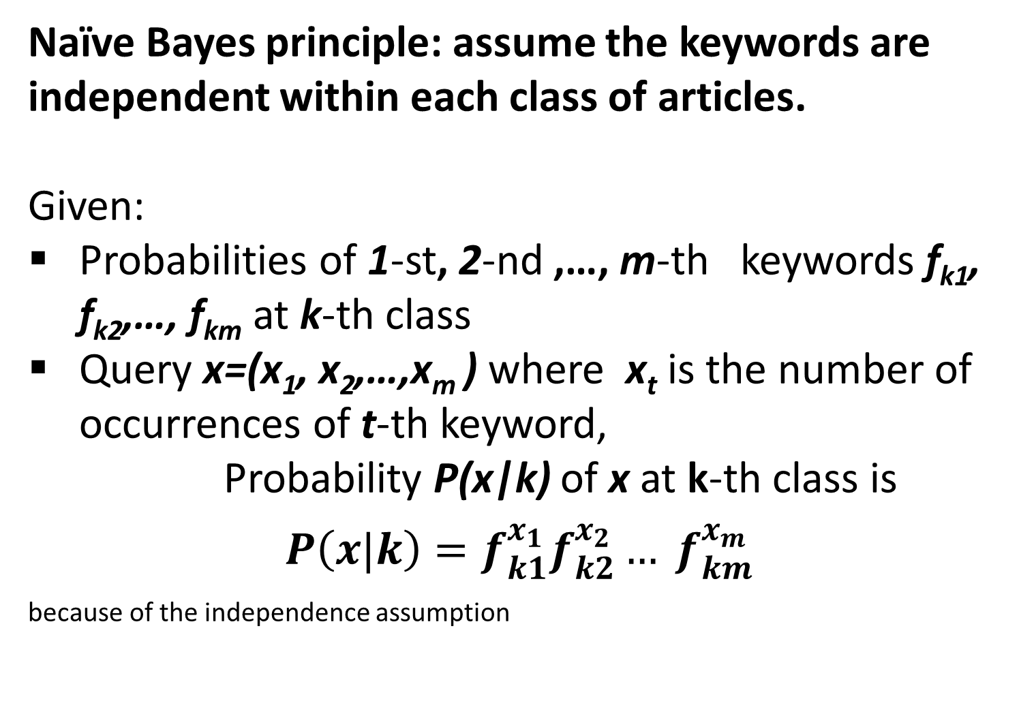
Week 8. III: Naïve Bayes classifier rule, 1
Naïve Bayes principle: assume the keywords are independent within each class of articles.
Given:
Probabilities of 1-st, 2-nd ,…, m-th keywords f_{k1}, f_{k2},…, f_{km} at k-th class
Query x=(x₁, x₂,…,x_{m} ) where x_{t} is the number of occurrences of t-th keyword,
Probability P(x|k) of x at k-th class is
$P\left(x|k\right)=f_{k1}^{x_{1}}f_{k2}^{x_{2}}… f_{km}^{x_{m}}$ because of the independence assumption

Slide 24
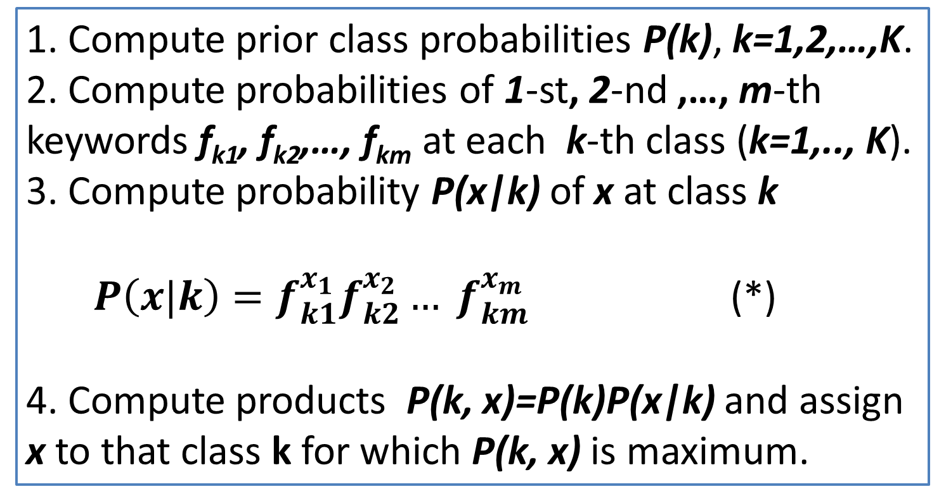
Week 8. III: Naïve Bayes classifier rule, 2
Naïve Bayes algorithm.
Given a database of classified articles with m keywords and query x=(x₁, x₂,…,x_{m} ) where x_{t} is the number of occurrences of t-th keyword
1. Compute prior class probabilities P(k), k=1,2,…,K.
2. Compute probabilities of 1-st, 2-nd ,…, m-th keywords f_{k1}, f_{k2},…, f_{km} at each k-th class (k=1,.., K).
3. Compute probability P(x|k) of x at class k
$P\left(x|k\right)=f_{k1}^{x_{1}}f_{k2}^{x_{2}}… f_{km}^{x_{m}}$ (*)
4. Compute products P(k, x)=P(k)P(x|k) and assign x to that class k for which P(k, x) is maximum.

Slide 25
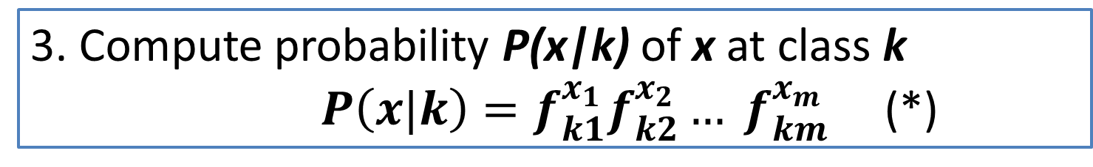
Week 8. III: Naïve Bayes classifier rule, 3
Naïve Bayes algorithm: a PITFALL
Given a database of classified articles with m keywords and query x=(x₁, x₂,…,x_{m} ) where x_{t} is the number of occurrences of t-th keyword
3. Compute probability P(x|k) of x at class k
$P\left(x|k\right)=f_{k1}^{x_{1}}f_{k2}^{x_{2}}… f_{km}^{x_{m}}$ (*)
Pitfall: The probabilities f_{kt} are small in applications, of the order of a thousandth or millionth.
The product (*) is very small then. Say, a product of a dozen of reals of the order of 0.001 each, will come out as a real of the order of unity divided by 10³⁶. This is a digital zero for all practical purposes.
Way out: Use logarithms instead.

Slide 26
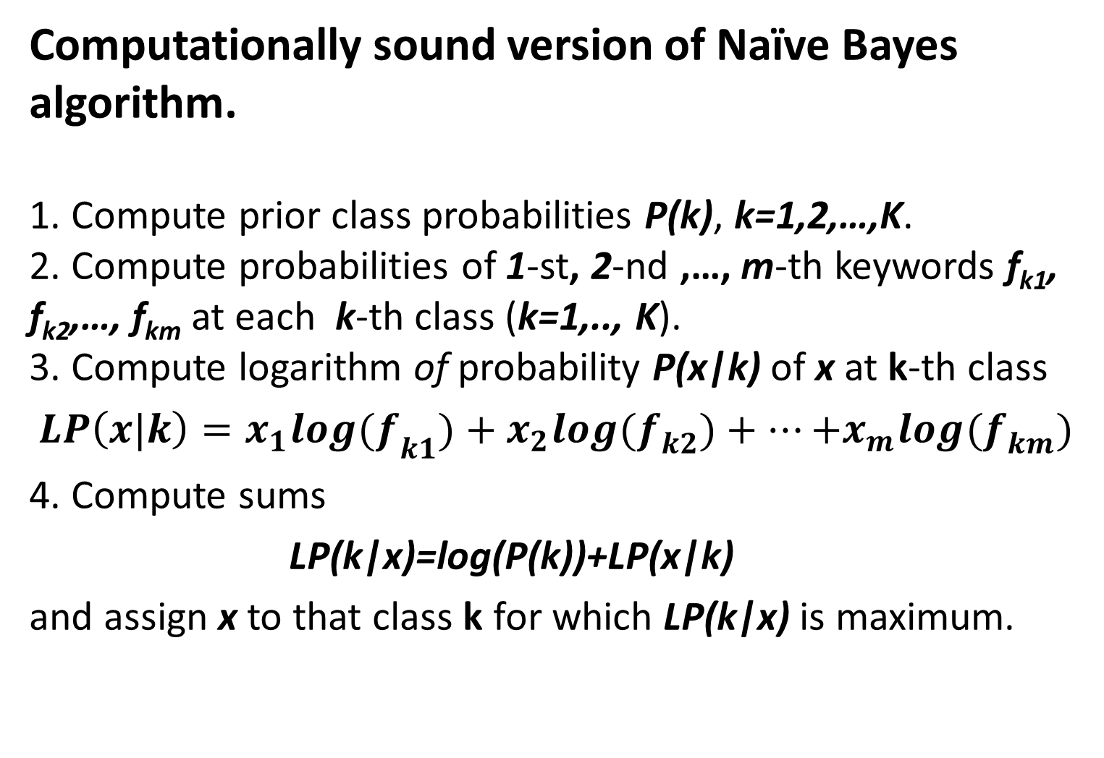
Week 8. III: Naïve Bayes classifier rule, 4
Computationally sound version of Naïve Bayes algorithm.
1. Compute prior class probabilities P(k), k=1,2,…,K.
2. Compute probabilities of 1-st, 2-nd ,…, m-th keywords f_{k1}, f_{k2},…, f_{km} at each k-th class (k=1,.., K).
3. Compute logarithm of probability P(x|k) of x at k-th class
$LP\left(x|k\right)={x_{1}log(f}_{k1}^{})+{x_{2}log(f}_{k2}^{})+…{+x_{m}log(f}_{km}^{})$
4. Compute sums
LP(k|x)=log(P(k))+LP(x|k)
and assign x to that class k for which LP(k|x) is maximum.

Slide 27
Week 8. IV: Probabilities of keywords,1
A crucial part of Naïve Bayes algorithm:
2. Computing probabilities of keywords within classes.
Article | Keyword
 | drink equal fuel play popular price relief talent tax woman
F1 F2 F3 F4 E1 E2 E3 E4 H1 H2 H3 H4 | 1 2 0 1 2 0 0 0 0 2 0 0 0 1 0 1 0 2 0 2 0 2 0 0 0 0 0 1 0 2 2 1 0 0 0 2 0 2 0 1 2 0 1 2 2 0 0 1 0 0 0 1 0 3 2 1 2 0 0 0 1 0 2 0 1 1 0 3 1 1 0 1 0 1 1 0 1 1 0 0 0 0 2 0 1 2 0 0 2 0 1 0 2 2 0 2 2 0 0 0 0 0 1 1 2 1 1 0 2 0 0 0 1 0 0 2 2 0 2 0

Slide 28
Week 8. IV: Probabilities of keywords, 2
A crucial part of Naïve Bayes algorithm:
2. Computing probabilities of keywords within classes.
Take a look, say, at class F and see what is going on.
First issue: Zero probability for keywords “fuel”, “relief”, and “tax” because of no occurrences. Not good because it would never assign an article x from the class to it if the article contains any of these keywords.
Article | Keyword
 | drink equal fuel play popular price relief talent tax woman
F1 F2 F3 F4 | 1 2 0 1 2 0 0 0 0 2 0 0 0 1 0 1 0 2 0 2 0 2 0 0 0 0 0 1 0 2 2 1 0 0 0 2 0 2 0 1

Slide 29
Week 8. IV: Probabilities of keywords, 3
A crucial part of Naïve Bayes algorithm:
2. Computing probabilities of keywords within classes.
Take a look, say, at class F and see what is going on.
Second issue: What probability should one assign to “woman”? A unity? And what is about “popular” or “equal”? How one should take into account the multiple occurrences?
Article | Keyword
 | drink equal fuel play popular price relief talent tax woman
F1 F2 F3 F4 | 1 2 0 1 2 0 0 0 0 2 0 0 0 1 0 1 0 2 0 2 0 2 0 0 0 0 0 1 0 2 2 1 0 0 0 2 0 2 0 1

Slide 30
Week 8. IV: Probabilities of keywords, 4
A crucial part of Naïve Bayes algorithm:
2. Computing probabilities of keywords within classes.
“Bag of words” model solves all!
Put in a “bag” all the keywords from the upper line of the table (the 10 of them). Add all the occurrences of all keywords in the category (3+5+0+2+2+3+0+5+ 0+7=27), 37 altogether. The probability of a keyword, say, “equal” is its total occurrence number, 5, plus 1, related to the bag size, 37: 6/37=0.1622.
Article | drink equal fuel play popular price relief talent tax woman
F1 F2 F3 F4 | 1 2 0 1 2 0 0 0 0 2 0 0 0 1 0 1 0 2 0 2 0 2 0 0 0 0 0 1 0 2 2 1 0 0 0 2 0 2 0 1

Slide 31
Week 8. IV: Probabilities of keywords, 5
A crucial part of Naïve Bayes algorithm:
2. Computing probabilities of keywords within classes with Bag of Words model.
For example, compute f_{drink,E}=(3+1)/(32+10)=4/42=0.0952.
Here 3 is the total number of occurrences of keyword “drink” in class E, and 32, the total number of occurrences of all the ten keywords in E, so that 42 is the size of bag of words for class E.
Class | Probabilities of keywords within classes
 | drink equal fuel play popular price relief talent tax woman
F E H | 0.108 0.162 0.027 0.081 0.081 0.108 0.027 0.162 0.027 0.216 0.095 0.071 0.095 0.167 0.167 0.071 0.095 0.143 0.048 0.048 0.049 0.024 0.171 0.098 0.098 0.195 0.146 0.024 0.171 0.024

Slide 32
Week 8. IV: Probabilities of keywords, 6
A crucial part of Naïve Bayes algorithm:
Take logarithms (natural here) of the probabilities above expressed in hundredth (to make all the logarithms positive):
Class | Within class probabilities of keywords
 | drink equal fuel play popular price relief talent tax woman
F E H | 0.108 0.162 0.027 0.081 0.081 0.108 0.027 0.162 0.027 0.216 0.095 0.071 0.095 0.167 0.167 0.071 0.095 0.143 0.048 0.048 0.049 0.024 0.171 0.098 0.098 0.195 0.146 0.024 0.171 0.024
Class | Logarithms of within class probabilities of keywords multiplied by 100
 | drink equal fuel play popular price relief talent tax woman
F E H | 2.380 2.786 0.994 2.093 2.093 2.380 0.994 2.786 0.994 3.074 2.254 1.966 2.254 2.813 2.813 1.966 2.254 2.659 1.561 1.561 1.585 0.892 2.838 2.278 2.278 2.971 2.683 0.892 2.838 0.892

Slide 33
Week 8. IV: Naïve Bayes - Final decision,1
Take logarithms of 100/3 (class probabilities being equal here): C=log(100/3)=3.5066.
Take vector of query x (bottom line in Table above) and compute inner product of it and each of the lines in Table:
3. Add respective results of 1 and 2.
4. Assign x to class of maximum of the found values.
Class | Logarithms of within class probabilities of keywords multiplied by 100
 | drink equal fuel play popular price relief talent tax woman
F E H | 2.380 2.786 0.994 2.093 2.093 2.380 0.994 2.786 0.994 3.074 2.254 1.966 2.254 2.813 2.813 1.966 2.254 2.659 1.561 1.561 1.585 0.892 2.838 2.278 2.278 2.971 2.683 0.892 2.838 0.892
x | 1 1 2 1 1 0 0 1 0 0

Slide 34
Week 8. IV: Naïve Bayes - Final decision,2
Take vector of query x (bottom line in Table above) and compute inner product of it and each of the lines in Table:
AF=1*2.380+1*2.786+2*0.994+1*2.093+1*2.093+0*2.380+0*0.994+1*2.786+
0*0.994+0*3.074=14.127
AE=1*2.254+1*1.966+2*2.254+1*2.813+1*2.813+0*1.966+0*2.254+1*2.659+
0*1.561+ 0*1.561 = 17.014
AH=1*1.585+1*0.892+2*2.838+1*2.278+1*2.278+0*2.971+0*2.683+1*0.892+
0*2.838+0*0.892 = 13.600
Class | Logarithms of within class probabilities of keywords multiplied by 100
 | drink equal fuel play popular price relief talent tax woman
F E H | 2.380 2.786 0.994 2.093 2.093 2.380 0.994 2.786 0.994 3.074 2.254 1.966 2.254 2.813 2.813 1.966 2.254 2.659 1.561 1.561 1.585 0.892 2.838 2.278 2.278 2.971 2.683 0.892 2.838 0.892
x | 1 1 2 1 1 0 0 1 0 0

Slide 35
Week 8. IV: Naïve Bayes - Final decision,3
3. Add respective results of 1 and 2:
AF+C=17.633; AE+C=20.520; AH+C=17.105
4. Assign x to class of maximum value, E,
in this case. (Indeed, x is for an article from E)
Class | Logarithms of within class probabilities of keywords multiplied by 100
 | drink equal fuel play popular price relief talent tax woman
F E H | 2.380 2.786 0.994 2.093 2.093 2.380 0.994 2.786 0.994 3.074 2.254 1.966 2.254 2.813 2.813 1.966 2.254 2.659 1.561 1.561 1.585 0.892 2.838 2.278 2.278 2.971 2.683 0.892 2.838 0.892
x | 1 1 2 1 1 0 0 1 0 0

Slide 36
Week 8. Correlation rules Part 5 Classification trees over Iris
Petal width Petal length
≤0.6 >0.6 ≤2.6 >2.6
Petal width Petal length
Setosa ≤1.7 >1.7 Setosa ≤4.85 >4.85
50/50 50/50
Versicolor Virginica Versicolor Virginica
49/54 45/46 46/49 47/51
6 errors 7 errors
From Mirkin (2011) From http://www.ibm.com/deve
loperworks/library/ba-predictive-analytics2

Slide 37
Week 8. Part 5. Classification tree,1
Petal width
≤0.6 >0.6
Petal width
Setosa ≤1.7 >1.7
50/50
Versicolor Virginica
49/54 45/46
6 errors
From Mirkin (2011)
Classification tree building over a training set, given a target partition H.
Goal: to build a partition G maximally similar to H by sequentially splitting a cluster over a feature.
Start: G consisting of one cluster, the dataset.

Slide 38
Week 8. Part 5. Classification tree,2
Petal width
≤0.6 >0.6
Petal width
Setosa ≤1.7 >1.7
50/50
Versicolor Virginica
49/54 45/46
6 errors
From Mirkin (2011)
Classification tree building over a training set, given a target partition H.
A split is chosen as the best of the splits of all clusters available over all feature values available.

Slide 39
Week 8. Part 5. Classification tree,3
A split is chosen as the best of the splits of all clusters available over all feature values available.
Split scoring function evaluates the similarity between the target partition H and partition G being built. Among most popular scoring functions are Pearson chi-squared (this is used in popular statistics SPSS package, for example) , Information gain, Category utility function.

Slide 40
Week 8. Part 5. Split scoring, 1
A unifying framework for split scoring functions:
Take contingency table between target H and G being built p(Hk∩Gl) (co-occurrence frequency).
2. Define a reasonable function f(p(Hk∩Gl)) evaluating the extent of correlation between clusters Hk and Gl.
3. Score the similarity between G and H as the sum of all f(p(Hk∩Gl)) weighted by their frequencies p(Hk∩Gl).
The mentioned Pearson chi-squared, Information gain, Category utility function are of this type.

Slide 41
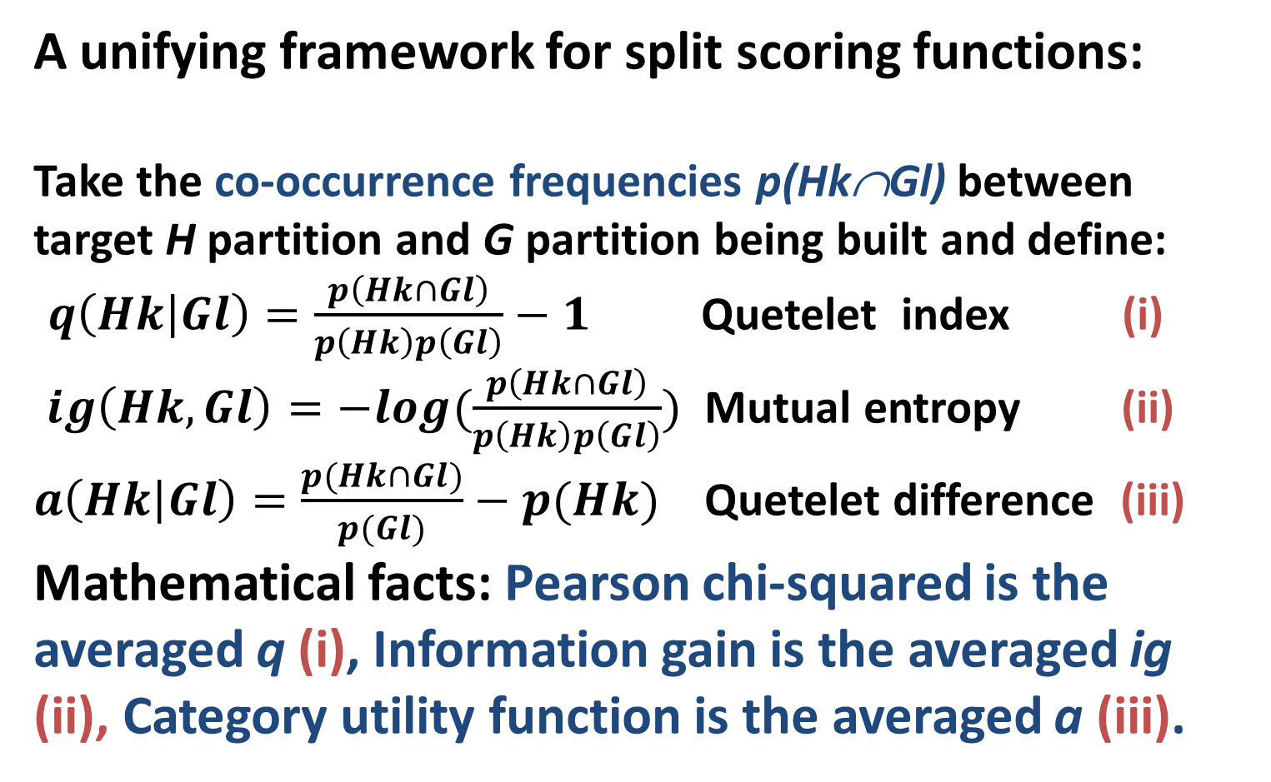
Week 8. Part 5. Split scoring, 2
A unifying framework for split scoring functions:
Take the co-occurrence frequencies p(Hk∩Gl) between target H partition and G partition being built and define:
$q\left(Hk | Gl\right)=\frac{p\left(Hk∩Gl\right)}{p\left(Hk\right)p\left(Gl\right)}−1$ Quetelet index (i)
$ig\left(Hk,Gl\right)=−log(\frac{p\left(Hk∩Gl\right)}{p\left(Hk\right)p\left(Gl\right)})$ Mutual entropy (ii)
$a\left(Hk | Gl\right)=\frac{p(Hk∩Gl)}{p(Gl)}−p(Hk)$ Quetelet difference (iii)
Mathematical facts: Pearson chi-squared is the averaged q (i), Information gain is the averaged ig (ii), Category utility function is the averaged a (iii).

Slide 42
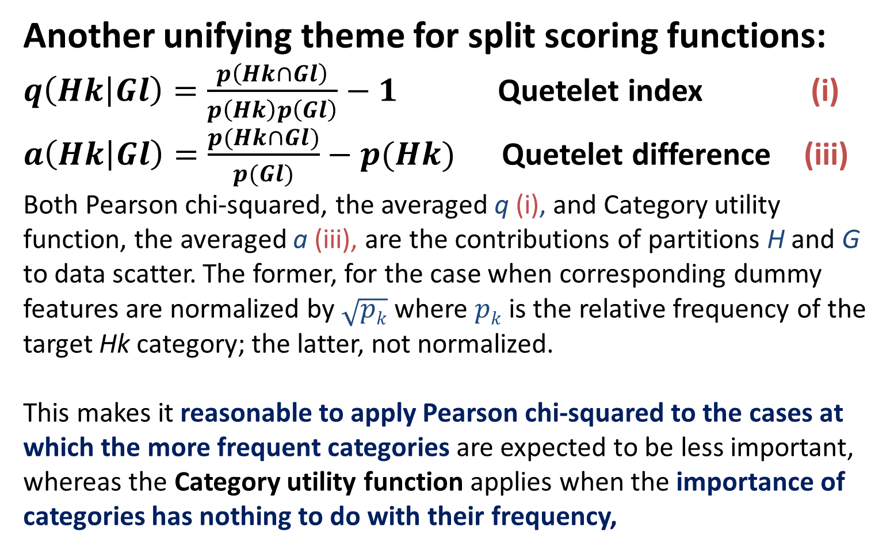
Week 8. Part 5. Split scoring, 3
Another unifying theme for split scoring functions:
$q\left(Hk | Gl\right)=\frac{p\left(Hk∩Gl\right)}{p\left(Hk\right)p\left(Gl\right)}−1$ Quetelet index (i)
$a\left(Hk | Gl\right)=\frac{p(Hk∩Gl)}{p(Gl)}−p(Hk)$ Quetelet difference (iii)
Both Pearson chi-squared, the averaged q (i), and Category utility function, the averaged a (iii), are the contributions of partitions H and G to data scatter. The former, for the case when corresponding dummy features are normalized by $\sqrt{pk}$ where $pk$ is the relative frequency of the target Hk category; the latter, not normalized.
This makes it reasonable to apply Pearson chi-squared to the cases at which the more frequent categories are expected to be less important, whereas the Category utility function applies when the importance of categories has nothing to do with their frequency,

Slide 43
Week 8. Part 5. An application: lift chart
In marketing research: lift is the relative response rate of a segment of population to an advert.
Consider a sample divided in four clusters with response rates as in Table.
Baseline response rate is the mean:
0.1*30+0.4*10+0.25*4+0.25*0=8%
The lift of the first cluster is then 30/8=3.75, and that of the first two clusters is 14/8=1.75 because the response rate in their union is 14%.
Cluster share, % | 10 40 25 25
Response rate, % | 30 10 4 0

Slide 44
Week 8. Part 6. Metrics of Accuracy, 1
Consider a classifier like that presented in Table, a lung screening device to diagnose lung cancer.
There are 1+7=8 errors out of 200. Therefore, the accuracy is 192/200=96%, and error is 4%. These are too general and can be misleading sometimes.
 |  | True lung cancer | Total
 |  | Yes No
Device’s diagnosis | Yes | 94 7 | 101 99
 | No | 1 98
Total |  | 95 105 | 200

Slide 45
Week 8. Part 6. Metrics of Accuracy, 2
Lung screening device errors and accuracy.
1) There are two kinds of error: 7 False Positives and 1 False Negative, which may be of different cost. A FP will be identified in additional tests, whereas a FN may cause trouble because of a late diagnosis.
 |  | True lung cancer | Total
 |  | Yes No
Device’s Diagnosis | Yes | 94 7 | 101 99
 | No | 1 98
Total |  | 95 105 | 200

Slide 46
Week 8. Part 6. Metrics of Accuracy, 3
Lung screening device errors and accuracy.
2) There can be difference in correctly identified cases, True Positives and True Negatives, when a less balanced sample is screened.
 |  | True lung cancer | Total
 |  | Yes No
Device’s Diagnosis | Yes | 94 7 | 101 99
 | No | 1 98
Total |  | 95 105 | 200

Slide 47
Week 8. Part 6. Metrics of Accuracy, 4
Lung screening device errors and accuracy at a crowd at large.
2) There can be difference in correctly identified cases, True Positives and True Negatives, because of an imbalanced sample. The accuracy here is high, 197/200=98.5%. But 1/3 of cancer sufferers is misdiagnosed, and ½ of “Yes” diagnoses are wrong.
 |  | True lung cancer | Total
 |  | Yes No
Device’s Diagnosis | Yes | 2 2 | 4 196
 | No | 1 195
Total |  | 3 197 | 200

Slide 48
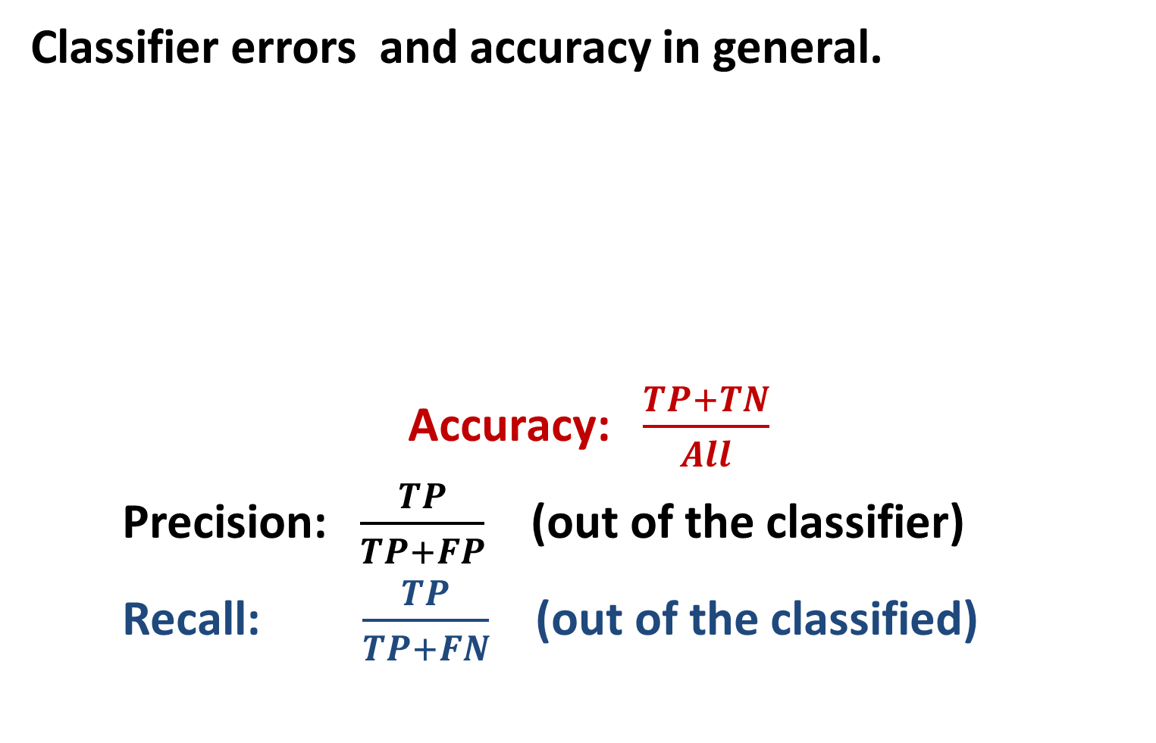
Week 8. Part 6. Metrics of Accuracy, 5
Classifier errors and accuracy in general.
Accuracy: $\frac{TP+TN}{All}$
Precision: $\frac{TP}{TP+FP}$ (out of the classifier)
Recall: $\frac{TP}{TP+FN}$ (out of the classified)
 |  | True lung cancer | Total
 |  | Yes No
Device’s Diagnosis | Yes | TP FP | TP+FP FP+TN
 | No | FN TN
Total |  | TP+FN FN+TN | All

Slide 49
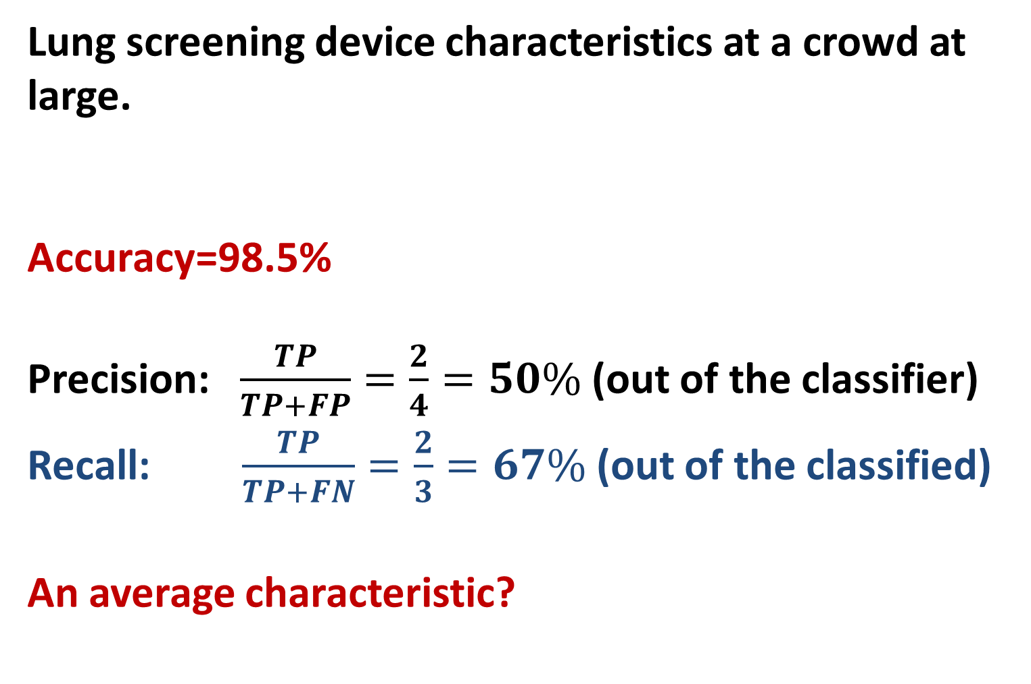
Week 8. Part 6. Metrics of Accuracy, 6
Lung screening device characteristics at a crowd at large.
Accuracy=98.5%
Precision: $\frac{TP}{TP+FP}=\frac{2}{4}=50\%$ (out of the classifier)
Recall: $\frac{TP}{TP+FN}=\frac{2}{3}=67\%$ (out of the classified)
An average characteristic?
 |  | True lung cancer | Total
 |  | Yes No
Device’s Diagnosis | Yes | 2 2 | 4 196
 | No | 1 195
Total |  | 3 197 | 200

Slide 50
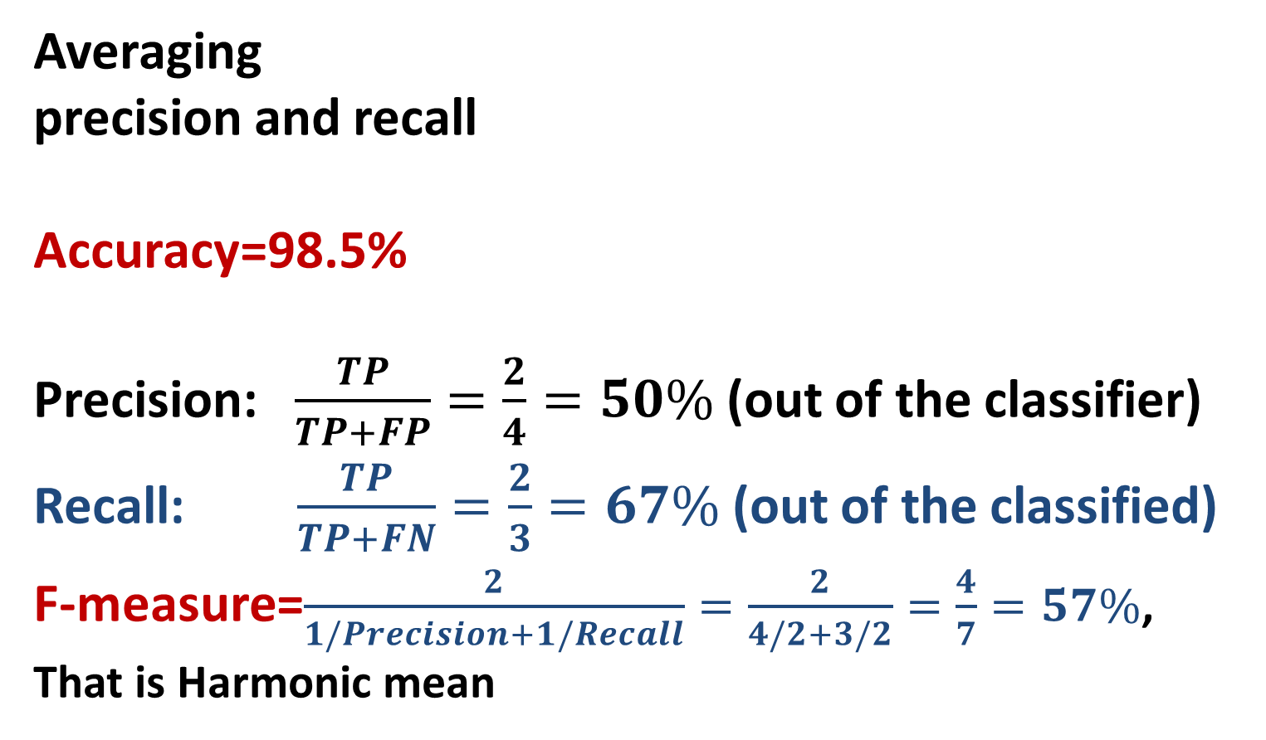
Week 8. Part 6. Metrics of Accuracy, 7
Averaging
precision and recall
Accuracy=98.5%
Precision: $\frac{TP}{TP+FP}=\frac{2}{4}=50\%$ (out of the classifier)
Recall: $\frac{TP}{TP+FN}=\frac{2}{3}=67\%$ (out of the classified)
F-measure=$\frac{2}{1/Precision+1/Recall}=\frac{2}{4/2+3/2}=\frac{4}{7}=57\%$,
That is Harmonic mean
 |  | True lung cancer | Total
 |  | Yes No
Device’s Diagnosis | Yes | 2 2 | 4 196
 | No | 1 195
Total |  | 3 197 | 200

Slide 51
Week 8. Correlation rules
Summary of subjects covered
1. Popular correlation structures: Six of them mentioned – Linear regression, Econometric structural model, Hidden Markov chain, Bayes network, Neural network, Decision tree
2. Bayes approach to prediction and Naïve Bayes classifier: Posterior probability can be a powerful tool.
3. Assigning articles to categories: Naïve Bayes algorithm employing a wrong assumption that the features are independent; using logarithms in it to avoid “infinitely” small numbers.
4. Bag-of-words text model: a simple device to estimate individual keyword probabilities.

Slide 52
Week 8. Correlation rules
Summary of subjects covered
5. Decision tree and splitting criteria: uncommon properties of popular splitting criteria including an assumption underlying the chi-squared that the feature weight is inversely related to its frequency.
6. Metrics of accuracy: an innate property – there are two different types of error reflected in the measures of recall and precision.

